Slide 1
Week 10
Chemical equations, moles and mass

Slide 2
Quantities in chemical reactions
The coefficients in a balanced chemical equation give the relative number of molecules, formula units or moles of each substance in the reaction. The actual amounts of each substance is always in the same ratio as the coefficients.

Slide 3
Mole to mole calculations
The molar amount of any two substances used or produced in a reaction is in the same ratio as their stoichiometric ratio. This is the ratio of their coefficients in the balanced equation.
Consider the general equation given below:

Slide 4
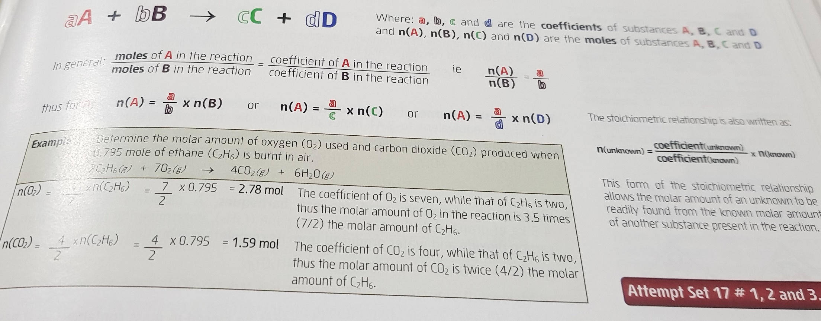

Slide 5
Calculations involving mass and moles
If the mass of any one substance involved in a reaction is known, then by converting this to an equal amount in moles (n=m/M), molar amounts of all other substances in the reaction can be found.
Once the molar amount is found, using m = nM mass of a substance can be found.

Slide 6
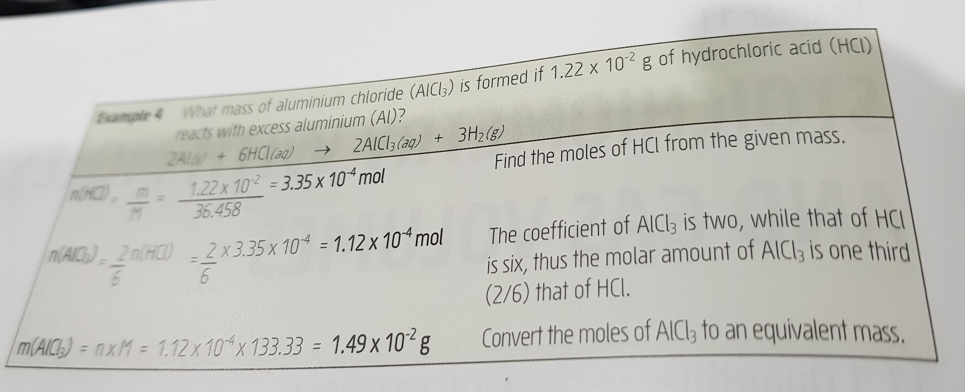

Slide 7
Complete questions ( 1,2 and 3) from Set 17 EC Unit 1&2

